Slide 1
Developer Environment Setup
Hands on Lab
Questions: brand@microsoft.com

Slide 2
Agenda
Developer Environments
Tools
Language Specific SDKs
HOL – Set up your developer environment

Slide 3
Developer Environment Options
Where do you want to develop?
Locally
Windows
Linux/OSX
Remote
Cloud developer images
What language or framework do you use?
SDKs available in most popular languages
REST API’s are available
Samples are everywhere

Slide 4
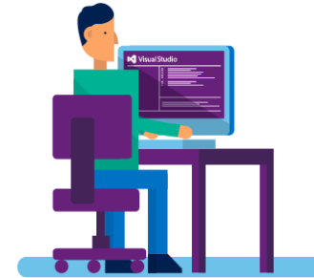
A Suite of Azure Developer Tools and SDKs
Visual Studio 2013, 2015, and 2017
App Services
Connected Services
WebJobs
PowerShell Editing
Debugging
Integrated DevOps
Azure SDK for .NET & Java
Cloud Services
Azure Resource Manager (ARM, IaaS VMs)
Azure Resource Optics via Cloud Explorer
Diagnostics for Cloud Services, VMs and VMSS
Data Factory Tools
Visual Studio Tools for Docker – Preview
Azure Service Fabric Tools for Visual Studio
Language SDKs
Azure SDK for Java
Azure SDK for Node.js
Azure SDK for Python
Azure SDK for Ruby
Azure SDK for PHP
Azure SDK for Go
Command-Line Tools
Azure Command-Line Interface
Azure PowerShell
Standalone Tools
Visual Studio Code and extensions (ARM, ASP.NET Core)
Microsoft Azure Storage Explorer
Azure Toolkit for Eclipse and IntelliJ
Docker Tools (Visual Studio Code, Visual Studio Team Services, and Yeoman Generator for Docker)
Azure DevTest Labs
Java
PHP
Data
App
Notes:
We release a lot of different tools to help you develop apps for Azure.
There is a lot you can do, without having to leave Visual Studio:
restart servers in Azure directly from Visual Studio
debug you web application or Service Fabric services running in Azure, directly from Visual Studio.
configure diagnostics settings on your cloud services from Visual Studio.
even create new resources, like VMs, web apps and storage account for your applications.
We even provide local-only emulators and
When you need to interact with Azure services in your applications, you are almost certain to find the programming language you use among our SDKs.
If you are more to CLI and PowerShell, we have great support for that as well.
We also so have standalone tools like Storage Explorer to help you.

Slide 5
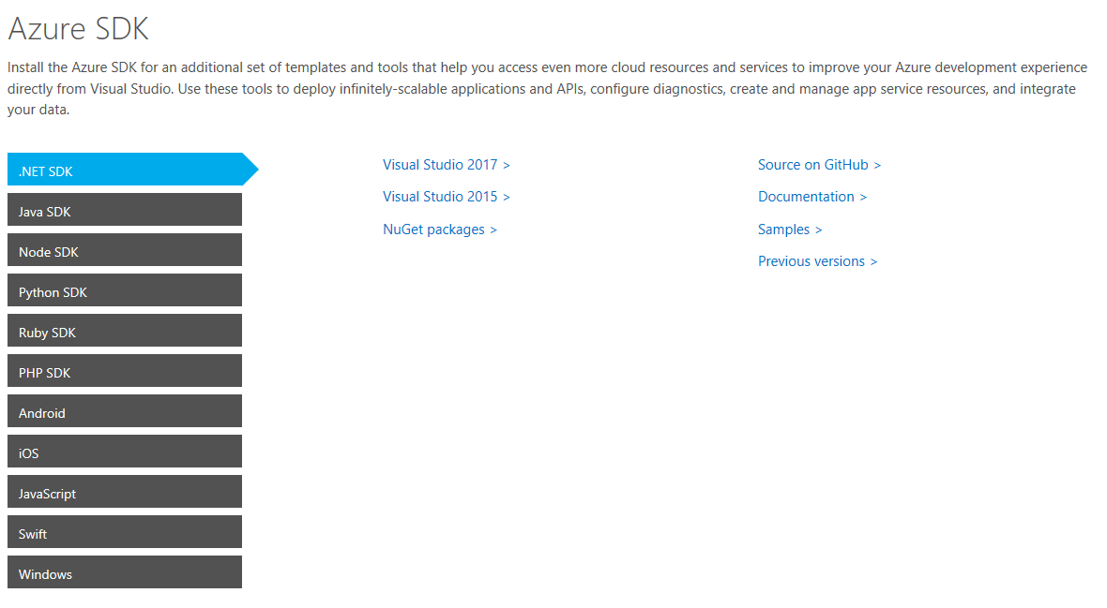
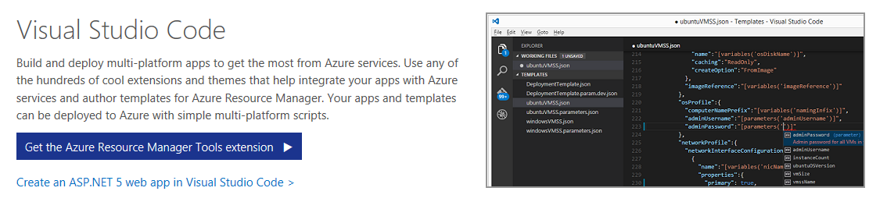
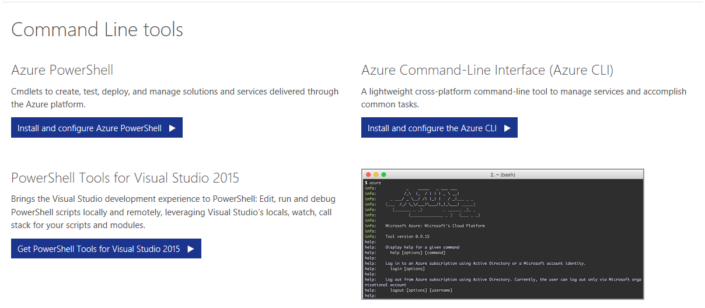
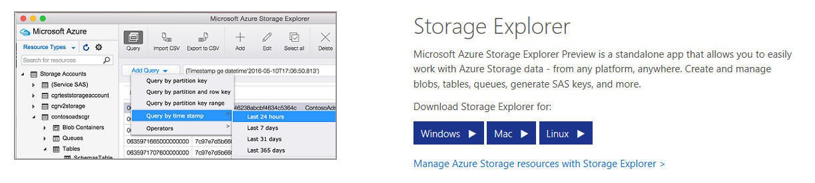
Tools and SDKs
Cross platform editor
Cross platform CLI
Cross platform storage viewer
https://azure.microsoft.com/en-us/tools/
https://github.com/azure/azure-rest-api-specs

Slide 6
Azure Tools
Azure Tools
https://azure.com/tools
Storage Explorer
http://storageexplorer.com
Visual Studio
https://www.visualstudio.com/vs/azure-tools
Visual Studio Code
https://code.visualstudio.com
Azure PowerShell
http://aka.ms/webpi-azps
Notes:
Before you leave:
Remember how you can build great applications, using our suite of open and flexible tools and unlock the possibilities the cloud has brought to us.
By now you should be well aware, that we have tools available that fit’s your needs and across tasks, roles and preference of OS.
Make sure to use the tools you know and love
get what you need at this website
sign-up for your Azure benefits and start building cloud apps today

Slide 7
EDU Specific Tools and Links
Install the Microsoft School Data Sync Toolkit
https://support.office.com/en-us/article/Install-the-School-Data-Sync-Toolkit-8e27426c-8c46-416e-b0df-c29b5f3f62e1?ui=en-US&rs=en-US&ad=US
http://aka.ms/classroomsetup
http://sds.microsoft.com/
http://aka.ms/sdsdeployment

Slide 8
Node Dev Center – azure.com/node

Slide 9
azure.github.io

Slide 10
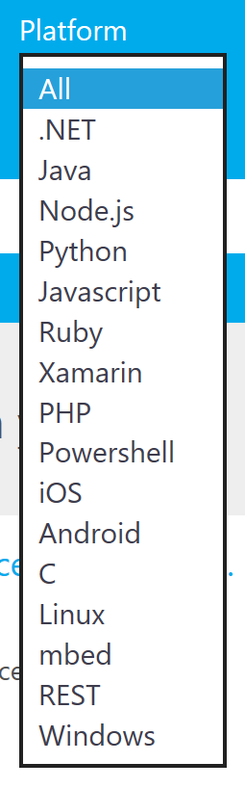
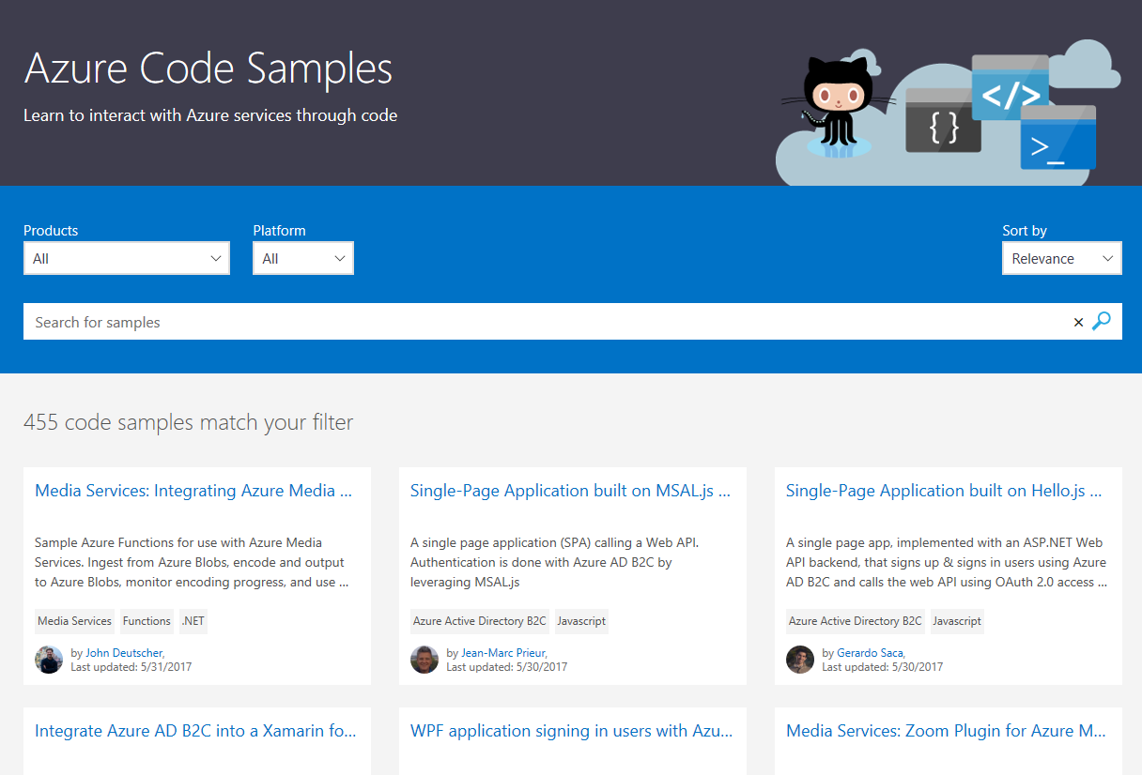
Azure Code Samples
https://azure.microsoft.com/en-us/resources/samples/

Slide 11
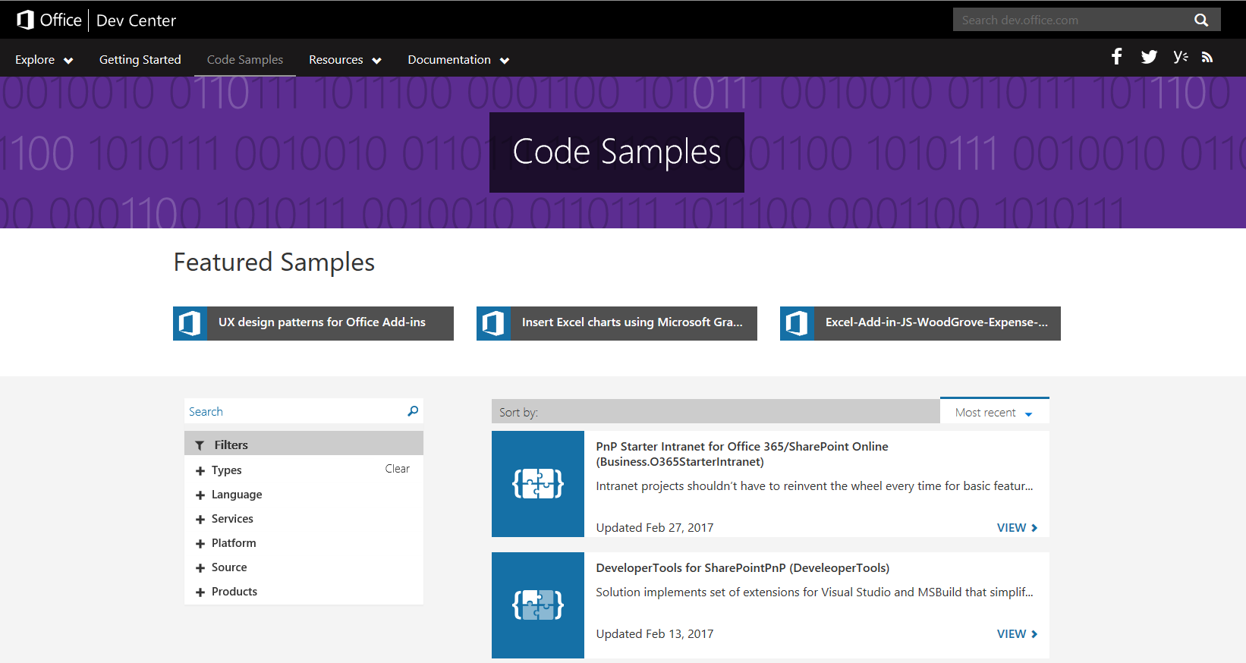
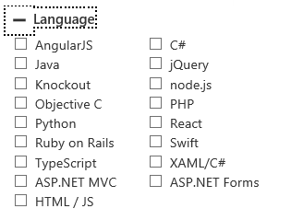
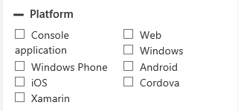
Office 365 Code Samples
https://dev.office.com/code-samples

Slide 12
Developer Accounts
Windows Azure
Azure trial: https://azure.microsoft.com/en-us/pricing/free-trial/
Azure Portal: https://portal.azure.com
Visual Studio
Dev Essentials - https://www.visualstudio.com/dev-essentials/
https://my.visualstudio.com
Office 365 Developer Site
Office 365 Developer Program - http://dev.office.com
O365 Portal: https://portal.office.com
GitHub Repos
http://www.github.com
http://www.github.com/office-dev
http://www.github.com/azure
http://www.github.com/azurecat-gsi
https://github.com/OfficeDev?q=edu
Developer Portals
http://dev.apps.microsoft.com
https://www.bingmapsportal.com
https://dev.office.com/microsoft-teams

Slide 13
Hands On Lab
Choose how you want to develop
Choose your language/framework
Set up your developer environment
Set up your developer accounts
Set up your EDU testing tenant
Connect to your developer environment

Slide 14

Questions?

